Slide 1

WICTU5 – A European Lions Club Engagement Presentation

Slide 2

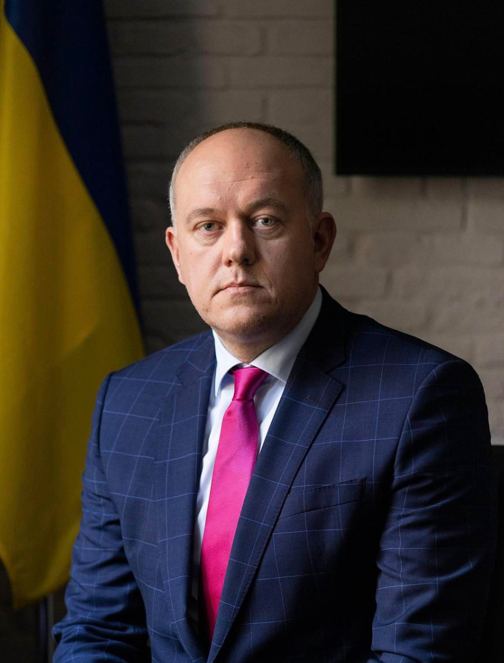

Our Patron
H.E. Mykhailo Vidoinyk Ambassador of Ukraine to Finland Honorary Patron of WICTU5 – One Class • One Child
Promoting international cooperation to support the future education of Ukrainian children.

Slide 3
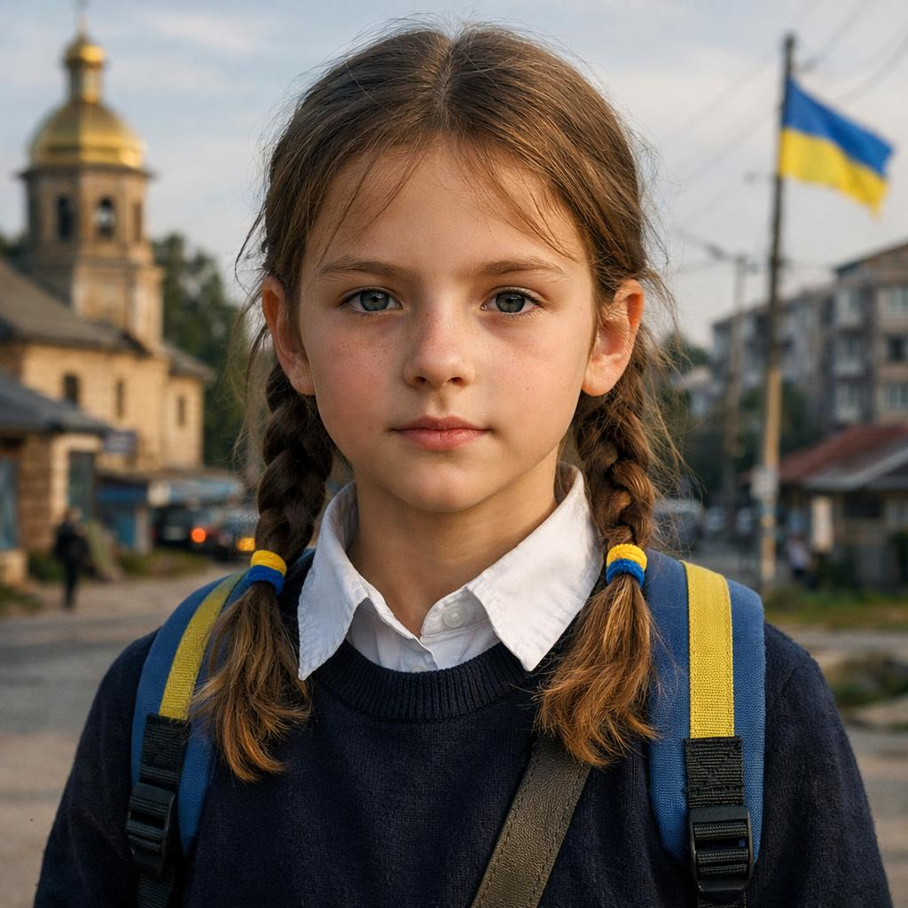
From Pandemic to War: A Generation of Disrupted Learning
Dual Crisis: The war intensified the severe learning disruptions originally caused by Covid 19.
Massive scale: More than 1.1 million children are currently studying remotely, according to the Ministry of Education of Ukraine(September ‘26), as many schools can no longer open safely due to:
Destroyed school buildings
Schools now in territory controlled by Russian forces
Lack of functioning bomb shelters
Schools too close to the front line to reach a shelter within the 3-minute air-raid warning
Years lost: Continuous, multi-year upheaval denies students normal classroom access and crucial socialisation.
Severe deficits: While enrolled students are roughly one year behind in mathematics, children who have not attended school since 2022 are now several years behind, with some effectively restarting their education

Slide 4

The Solution: Acer Chromebook 311
In Partnership with Google Europe
Humanitarian Pricing: Secured an exclusive rate of €220 per device (Standard European retail value is €280–€350).
Optimized Hardware: Engineered specifically to meet student educational demands
Full Management Suite: Includes Google Mobile Device Management (MDM) and Education Content Manager (ECM) software licensing.
Enhanced Safety: Equipped with instant remote-lock capabilities and pre-configured child-safe browsing settings.
Custom Brand Integration: Built with a reinforced custom chassis featuring WICTU5 and prominent donor logos.

Slide 5




About the campaign
“One Class – One Child” is part of the WICTU5 initiative, supported by
Embassy of Ukraine in the Republic of Finland
Although not an official partner we also wish to thank the Finnish Ministry of the Interior
for providing the safe transportation through the UCPM mechanism and covering the delivery costs of the laptops from Hamburg into Ukraine.
Their support has been essential in ensuring that every device reaches the children who need it most.
Thanks to humanitarian support from Google Europe, the project receives the devices for 220 €.Each laptop is made possible through a shared commitment. Typical contributions include:
Lions Club: 120 €
School class or club: 100 €
Or any combination that works for you
Every contribution—large or small—
helps bring one Ukrainian child back to education.

Slide 6
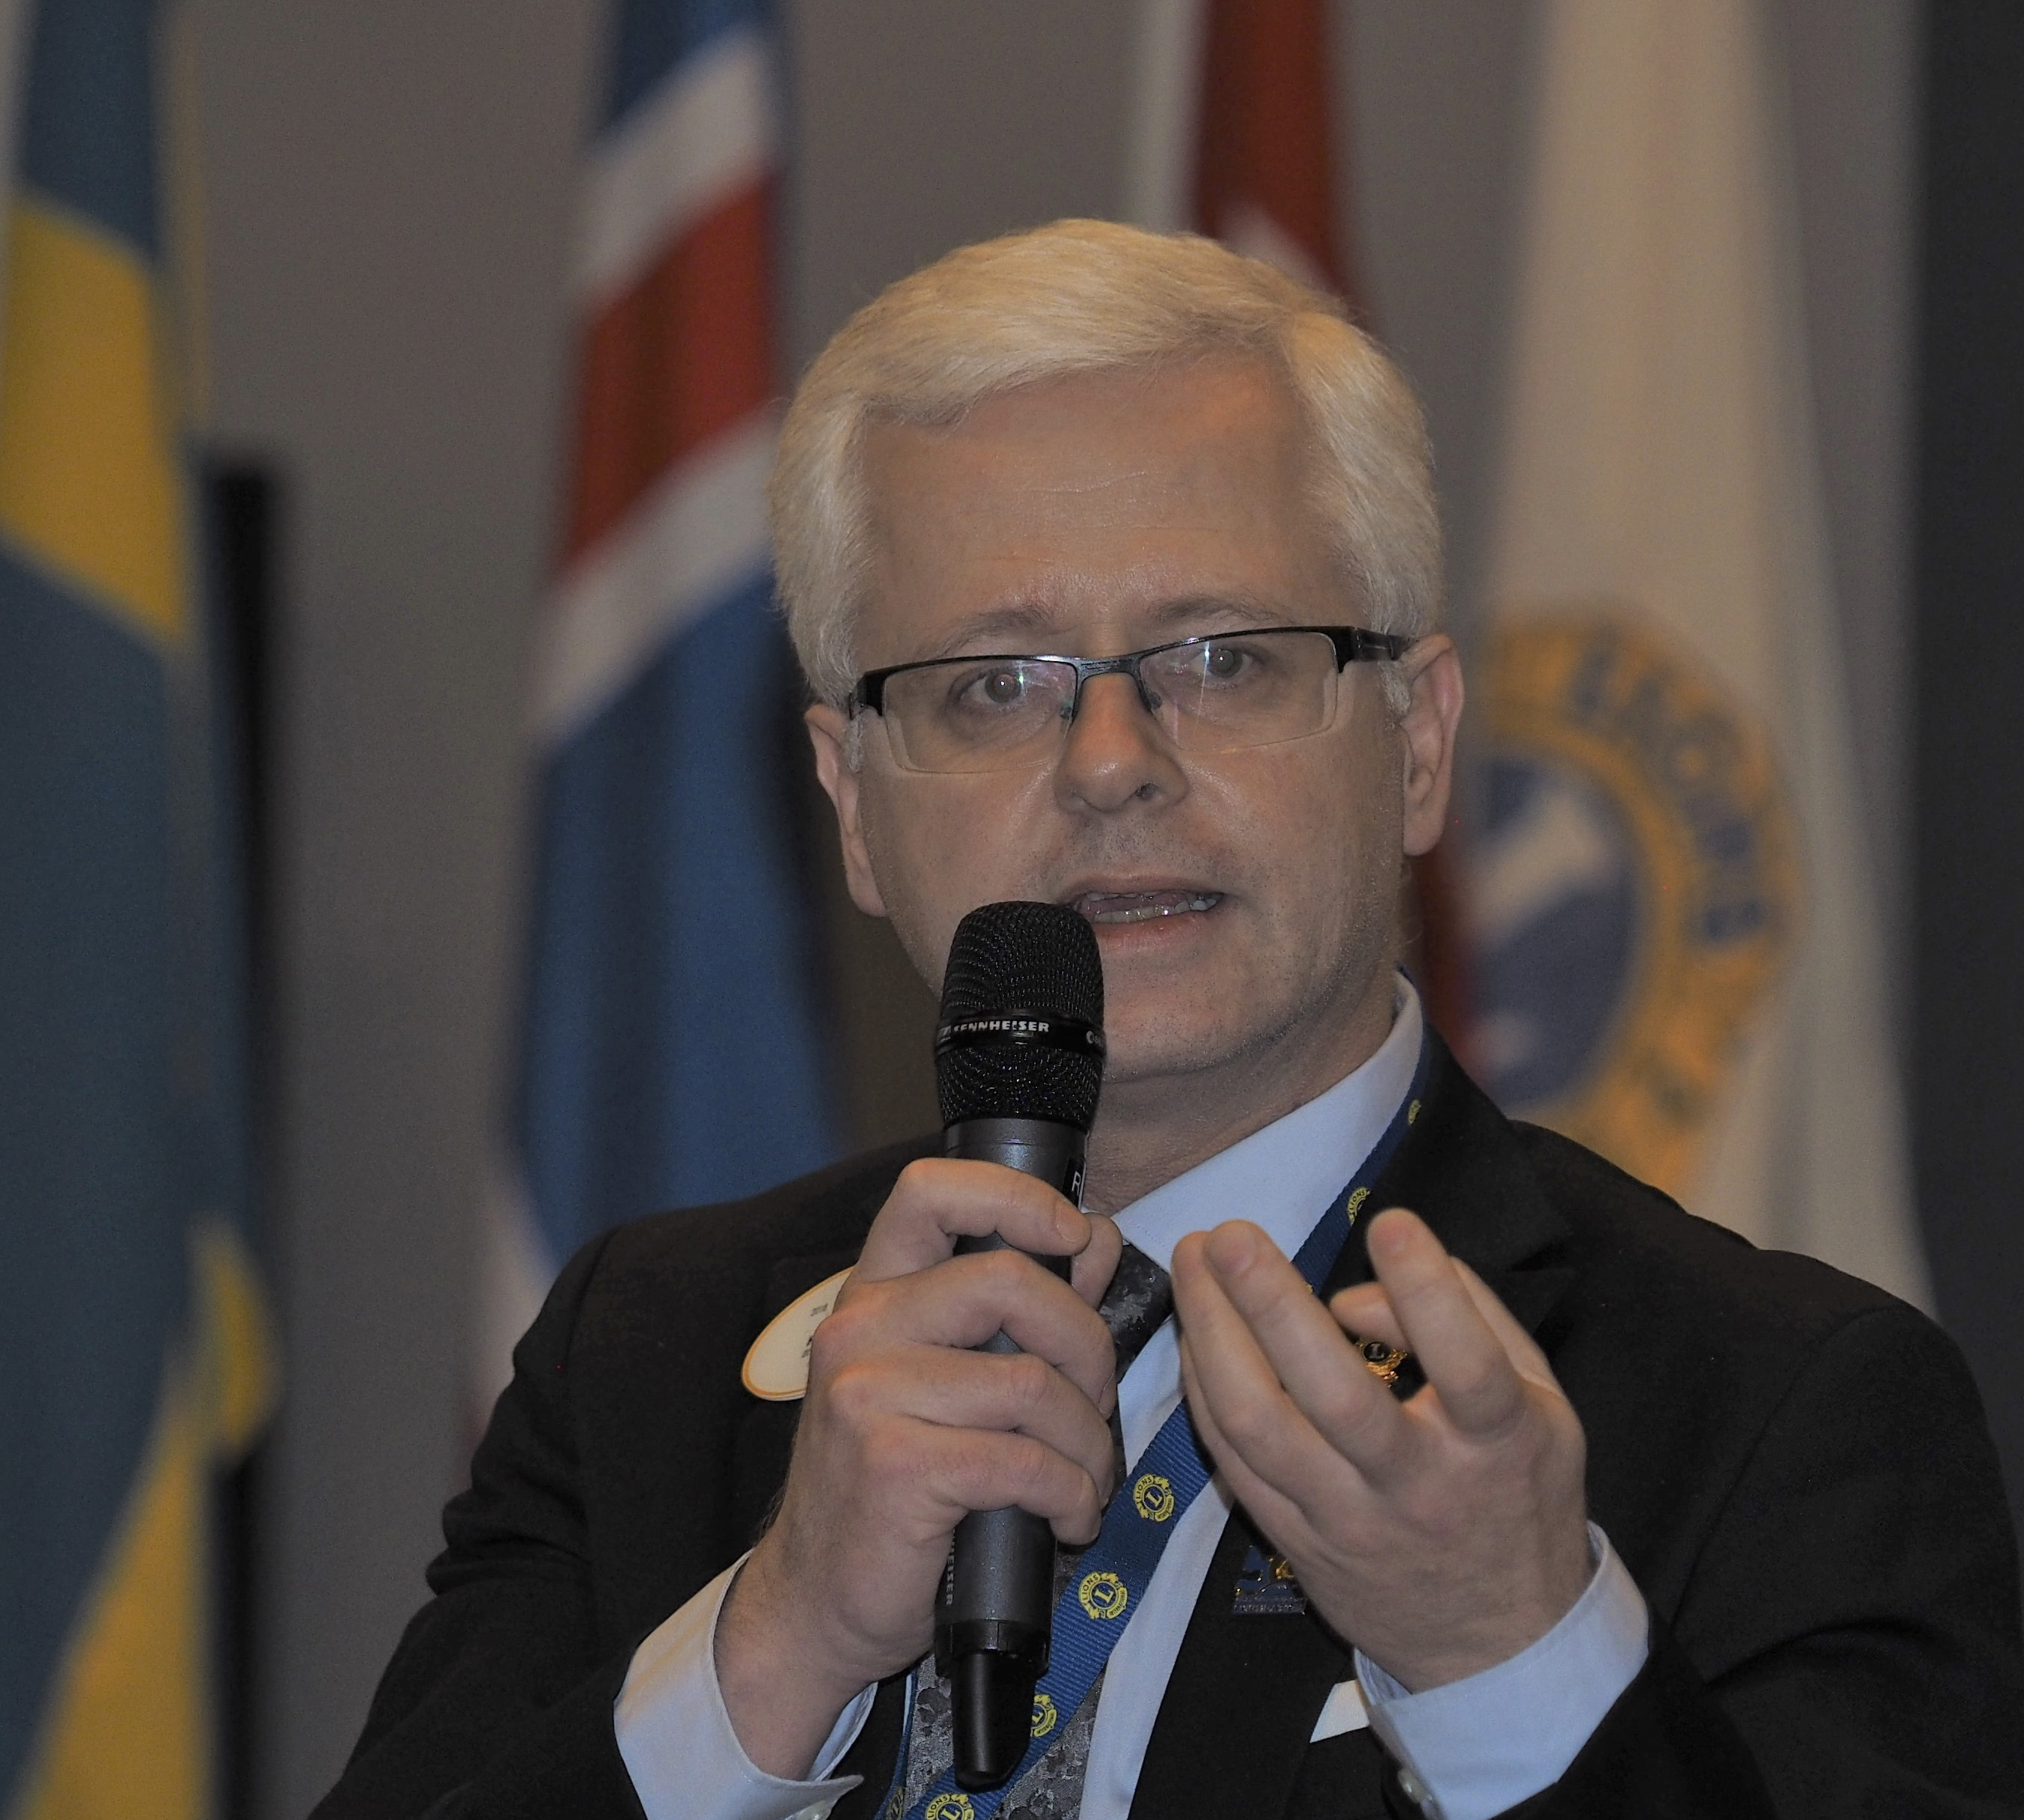
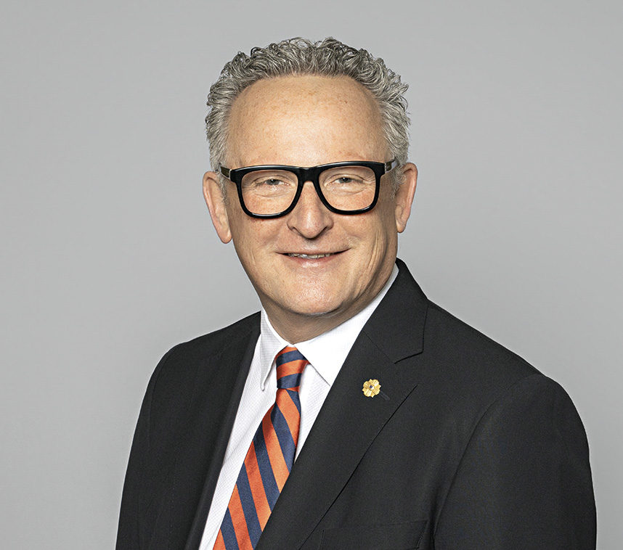
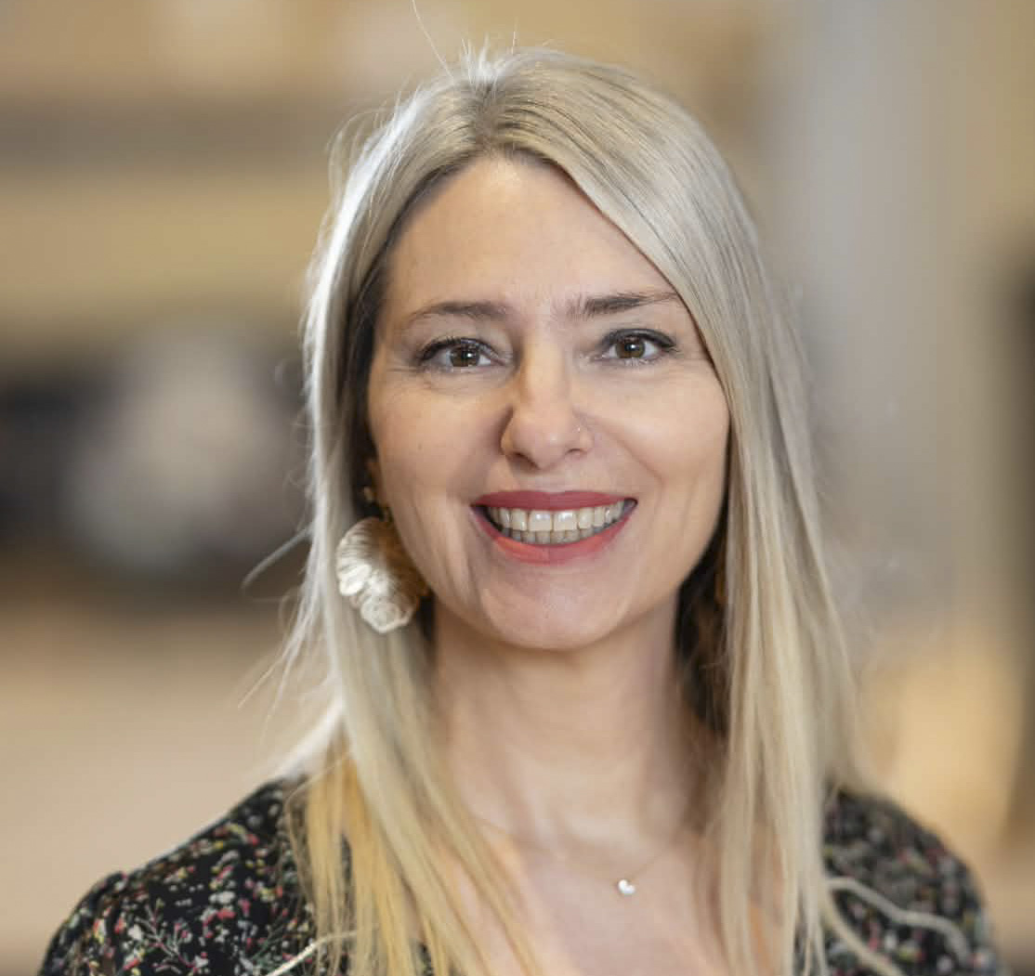
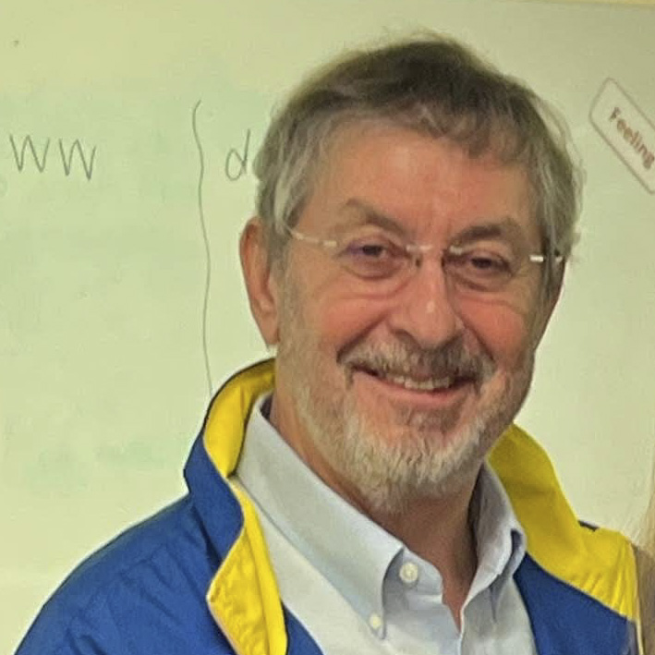
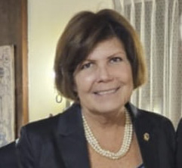
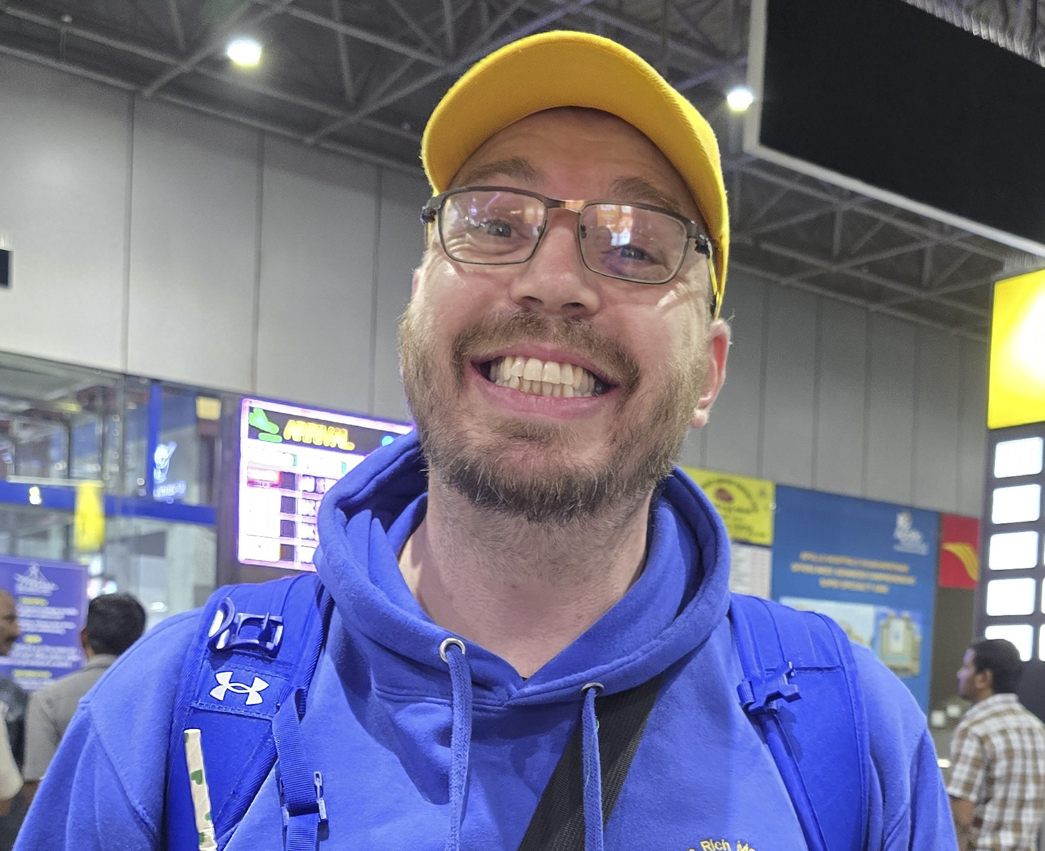
WICTU5 Management Team
PDG Björn Hägerstrand Project leader
PID Daniel Isenrich Financial Manager
PDG Vanessa Horrod School Manager
PID Phil Nathan Logistic Manager
Colette Case Recognitions manager
Rich Morris Marketing Manager

Slide 7

Your Lions Clubs responsibilities
CHOOSE YOUR CLUB’S CONTRIBUTION TARGET
Before contacting schools, your club should decide how many laptops you want to help provide. That number becomes your guiding target for the project.
2. REGISTER YOUR PARTICIPATION
If your country has a WICTU5 National Coordinator, contact them. If not, contact the WICTU5 School Campaign Coordinator directly
- Vanessa Horrod - vanessa@horrod.net
You will receive a starter package containing:
• the editable school presentation
• the official appreciation certificate from the Ministry of Education
• the standardized Excel reporting template

Slide 8

3. PREPARE YOUR SCHOOL PRESENTATION
Before sharing the presentation, fill in the following details:
• Your Lions Club name
• Your IBAN for donations
• Your contact person
• Your email address
Adding this information makes your club the official point of contact for local schools.

Slide 9
4. RECEIVE THE CLASS DONATION
Each class donates 100 € to your club’s bank account. Please transfer the funds to the German Lions Foundation, the official body responsible for administering all WICTU5 donations.
Important: To ensure we can send the class its “thank you” certificate, please include the following in the payment message:
• School name
• Class name
• Optional: A general class or school contact email (e.g., office@school.eu or class5b@school.eu)
Example: “School: Central School, Class: 5B, Email: office@school.eu”

Slide 10
Suggested class contribution: 100 €
This target helps Lions Clubs keep the project simple and consistent. At the same time, clubs are encouraged to stay flexible — every school is different. Smaller classes may contribute less, larger ones may contribute more.
What matters most is participation. Every contribution brings us closer to providing a laptop for a Ukrainian child.
Note: class or school email address will be used to send the official thank‑you certificate. If the class opts in, the Ukrainian student who receives the laptop may later send a direct message of thanks to this email address. This contact is optional and not supervised by Lions Clubs or the WICTU5 project team.

Slide 11
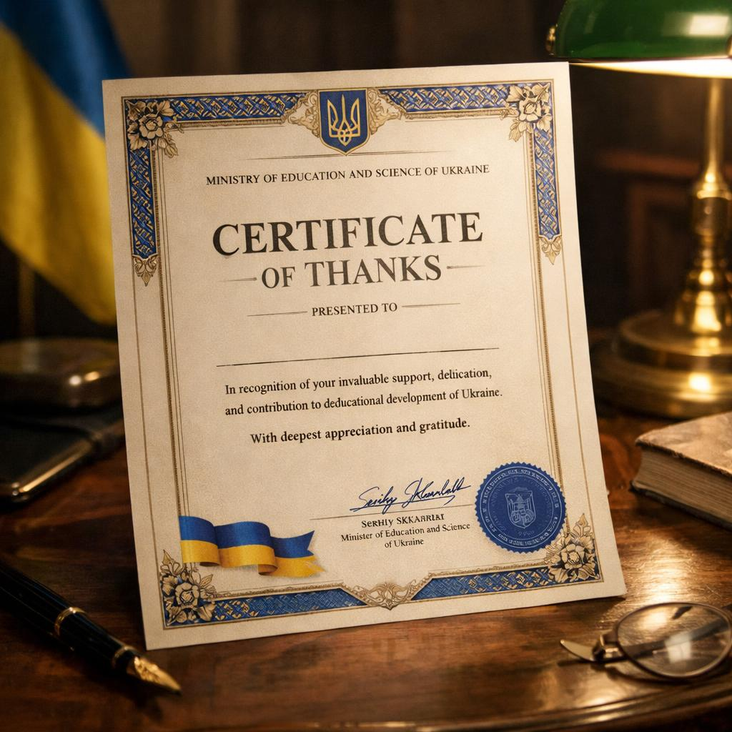
5. SEND THE OFFICIAL “THANK YOU” CERTIFICATE
Once the class donation has been received:
• Send the official thank‑you letter from the Ukrainian Ministry of Education to the class email address.
• You may also include a short greeting or message from your Lions Club.
Providing this immediate acknowledgement gives the class a sense of recognition and encourages their continued involvement.
In addition to the thank you certificate we also have a recognition programme, depending on amounts donated to WICTU5, for clubs, individual sponsors and corporate sponsorship – please see our website www.wictu.org for further details

Slide 12
6. TRANSFER DONATIONS TO THE WICTU5 PROJECT ACCOUNT
Your club collects all class and local contributions and then transfers the total amount to the official WICTU5 project bank account:
Account Owner: Stiftung der Deutschen Lions
Bank Name: Frankfurter Volksbank
IBAN: DE40 5019 0000 0000 4005 05
BIC: FFVBDEFFXXX
Please ensure your reference/note is as follows:
WICTU5; Name of Lions Club and District number or donor
This process ensures:
• Transparent accounting across all participating clubs
• Centralized reporting for the project
• Accurate allocation of funds to each laptop provided
The official project account details will be provided separately.

Slide 13
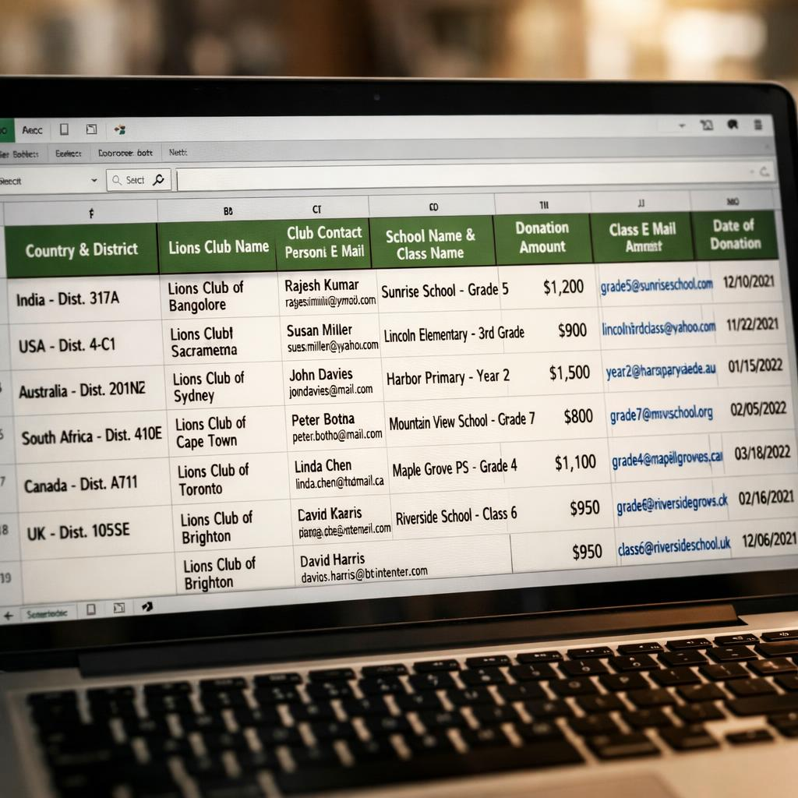
7. REPORT DONOR INFORMATION USING THE EXCEL TEMPLATE
Complete the standardized Excel file with the following details:
• Country and district
• Lions Club name
• Club contact person and email
• School name and class name
• Donation amount
• Class contact email
• Date the donation was received
Once completed, send the file to your WICTU5 Country Coordinator, if your country does not yet have a coordinator, please send the file to the WICTU5 School Campaign Coordinator - PDG Vanessa Horrod - vanessa@horrod.net
Centralizing this information ensures accurate record‑keeping and allows the project to reconnect students with their donor class if they wish to reach out in the future.

Slide 14


Recognition Programme
WICTU5 is not currently endorsed by LCIF, therefore donations made to the project are not eligible for Melvin Jones Fellowship credits.
In place of LCIF recognition, WICTU5 offers a unique, project‑specific recognition programme available exclusively to sponsors and supporters of the initiative. The programme features five levels of recognition, beginning at Bronze and progressing through to Diamond, each designed to honour the commitment of individuals, clubs and organisations who help Ukrainian children return to education.
Further details about each recognition level — including the criteria, benefits and how your club can participate — are available on our website www.wictu.org

Slide 15



8. OPTIONAL: STAY IN CONTACT WITH THE SCHOOL
If your club wishes, you may:
• Follow up with the school and share updates about the WICTU5 project
• Invite the school to future Lions activities
• Introduce the school to Lions youth projects, such as Leo Clubs, peace poster contests, youth engagement programmes, or local service initiatives.
Maintaining this connection helps strengthen the relationship between Lions and local education partners and encourages young people to become involved in Lions youth activities.

Slide 16
Synergy.
WICTU5
Leos & cubs
Youth Camps & exchange
Peace Poster
Peace Essay
Young Leaders in service
Young ambassador
WICTU5 integrates naturally with existing Lions youth programmes, creating a wider pathway for engagement and community impact.
It opens doors to additional initiatives such as vision screening, diabetes awareness, and other Lions International services — allowing parents, grandparents, and the broader community to experience the full value of Lions’ humanitarian work.
This deeper visibility not only strengthens community relationships but also inspires new members to join and support the mission.

Slide 17
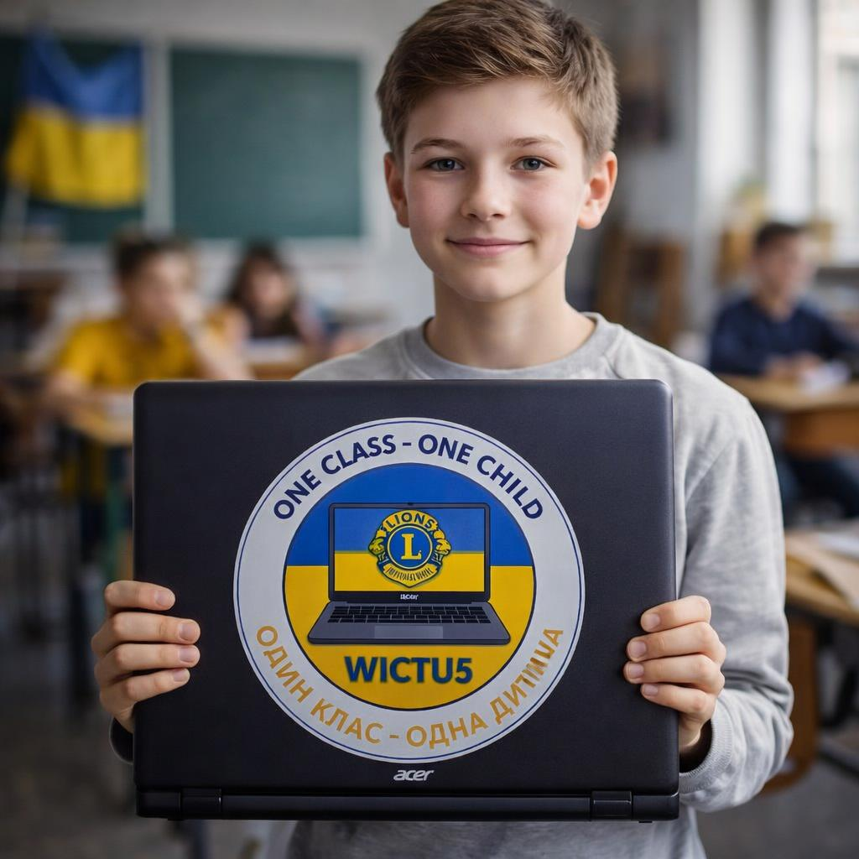
How contact with Ukrainian children works
When a class takes part in WICTU5, they have an option to provide a school‑controlled email address. This is usually a general office email or a teacher’s monitored inbox.
• Ukrainian authorities receive the class or school email addresses.
• If the class has opted in, the child who receives the laptop may choose to send a direct message of thanks once they have internet access.
• This contact is entirely voluntary and not supervised by Lions Clubs or the WICTU5 project team.
• This is voluntary and respectful of the children in Ukraine.

Slide 18
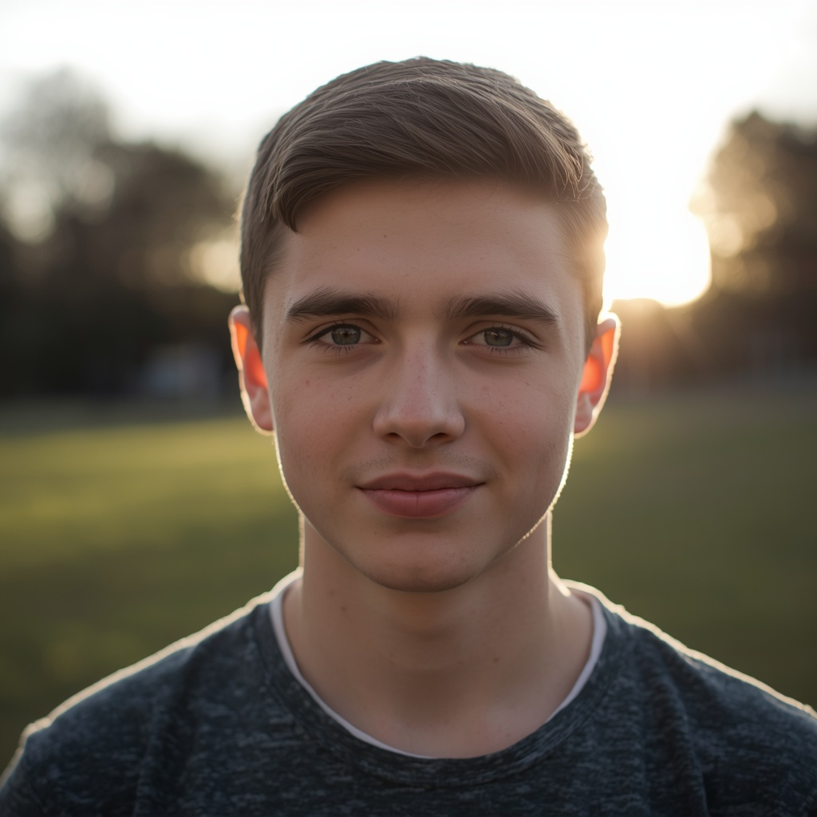
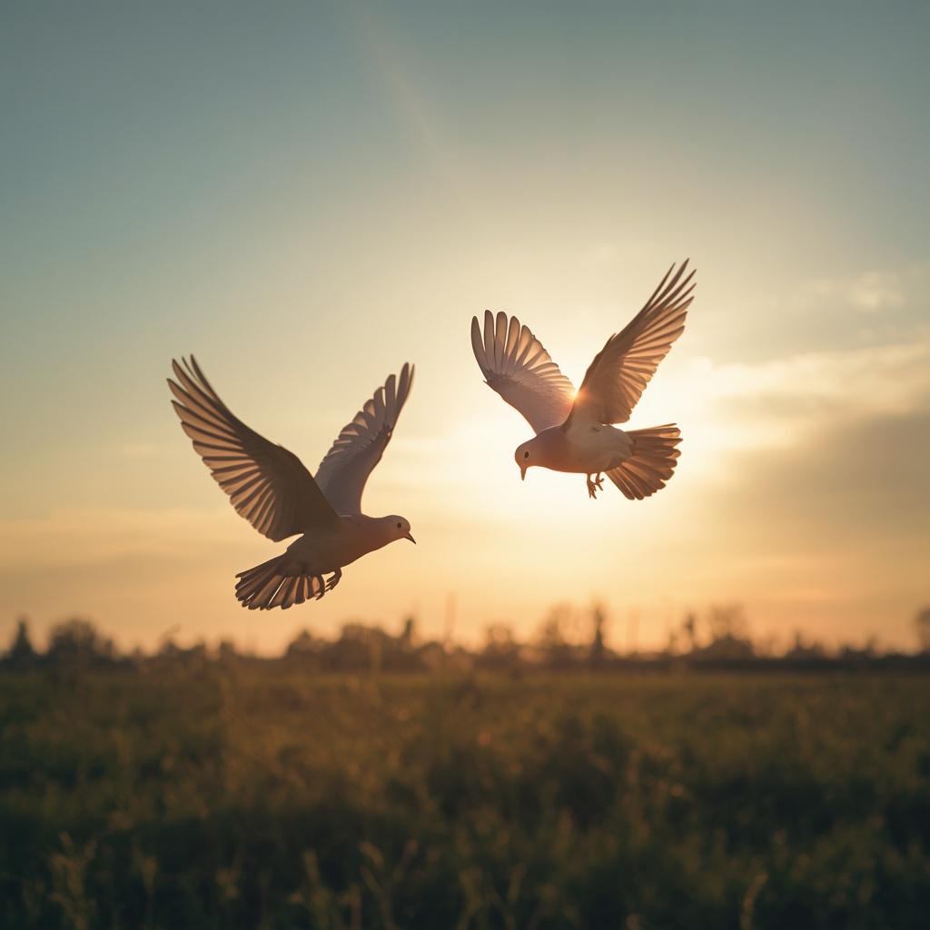
Join us in bringing 20,000 children back to school.
Together we create:
• Dignity
• Hope
• Opportunity
• A future
WICTU5 — A European movement for education and Lions youth empowerment.

Slide 19


For more information, please contact the multiple district co-ordinators:
MD103 France PDG Vanessa Horrod vanessa@horrod.net
MD105 British Isles PID Phil Nathan pidphil@yahoo.co.uk
MD107 Finland PDG Björn Hägerstrand bjorn@lions.ax
MD108 Italy ZC Colette Case cmcase@libero.it
MD111 Germany PID Daniel Isenrich daniel.isenrich@lions.de
Or
Go to our social media pages and website www.wictu.org
Thank you. The children count on your club’s support — and together, we can change their future.

